Slide 1


Snake Game
By: Team 10: Roshan Abhishek Deyon Siddharth Harshith

Slide 2


Introduction
The Snake Game, a classic arcade game, can be implemented in C programming to help developers practice core concepts like loops, arrays, and input handling. In this text-based version, the player controls a snake that moves around the screen, consuming food to grow longer while avoiding collisions with the walls or its own body. The game operates in a continuous loop, where the snake's movement is determined by user input (usually arrow keys), and the game ends when a collision occurs. The snake’s position and the food are displayed using ASCII characters, and a score is kept based on the number of food items consumed. Key components of the game include managing the snake’s body using arrays or linked lists, detecting collisions, generating food randomly, and updating the screen in real-time. This simple game structure can be enhanced by adding features like increasing difficulty, sound effects, and level progression, making it a fun and engaging way to practice programming skills in C.

Slide 3
Objective
The primary objective of developing the Snake Game in C programming is to provide an engaging project for beginners to learn fundamental programming concepts. It focuses on teaching basic control structures like loops, conditionals, and switch statements for managing game flow, such as snake movement and collision detection. The project also introduces array manipulation and data structures for tracking the snake's body and interactions with food. Students gain hands-on experience with real-time input handling and time-based operations, enabling responsive snake movements and controlled game speed. By implementing collision detection, random food generation, and score tracking, students develop critical problem-solving skills and functional game mechanics.

Slide 4
Features
Snake Movement: The snake moves continuously in one of four directions: up, down, left, or right. The movement is controlled by the player using keyboard input (W, A, S, D or arrow keys).
Food Generation: Food appears randomly on the grid. The snake grows longer when it eats the food.
Boundary Handling: Collision detection with walls (boundaries of the playfield) ends the game.
Self-Collision Detection: If the snake runs into itself, the game ends.
Score Tracking: A scoring system keeps track of the player's progress, increasing with each piece of food eaten.
Dynamic Snake Growth: The snake grows longer with each food item consumed, making navigation increasingly challenging.

Slide 5
Code
The Snake game code in C is built with clearly defined components, each serving a specific purpose to ensure smooth gameplay. It begins by including necessary libraries like <stdio.h> for input/output, <stdlib.h> for utility functions like random number generation, <conio.h> for real-time input handling, and <windows.h> for system-specific operations like cursor positioning and delays. Key constants such as WIDTH, HEIGHT, and MAX_SNAKE_SIZE define the game boundaries and maximum snake size. Core gameplay logic includes collision() to check if the snake hits walls or itself, move_snake() to update the snake’s position, and generate_food() to randomly place the food without overlapping the snake. The update() function integrates these elements, handling growth when food is eaten. Real-time user input is captured by input(), allowing direction changes while preventing the snake from reversing into itself.

Slide 6
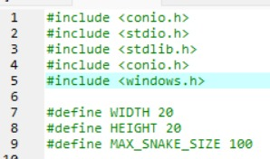
Header
#include <stdio.h>
Purpose:
Provides standard input and output functions such as printf() and scanf().
Usage in Code:
printf(): Used to display game elements such as the boundaries, snake, food, and messages (e.g., "Game Over!") to the console.

Slide 7
#include <stdlib.h>
Purpose:
Provides general-purpose functions including memory management, program control, random number generation, and more.
Usage in Code:
rand(): Generates random numbers to determine the position of the food.
system("cls"): Clears the console screen to redraw the game state in every iteration of the game loop.

Slide 8
#include <conio.h>
Purpose:
Provides console input/output functions specific to real-time and non-buffered input handling.
Usage in Code:
_kbhit(): Checks if a key has been pressed, allowing the game to detect user input without pausing the program.
_getch(): Captures the key pressed by the user to control the snake's direction (w, a, s, d).
and modularity.

Slide 9
#include <windows.h>
Purpose:
Offers Windows-specific functionality, including time delays, cursor control, and system-specific operations.
Usage in Code:
Sleep(milliseconds): Pauses the program for a specific duration to control the speed of the snake.
SetConsoleCursorPosition(): Positions the console cursor to redraw game elements efficiently, reducing flickering on the screen.
Other Components in the Header Section
#define Preprocessor Directives
Purpose:
Creates symbolic constants to improve code readability and maintainability.
Constants in Code:
WIDTH: Defines the width of the game grid.
HEIGHT: Defines the height of the game grid.
MAX_SNAKE_SIZE: Specifies the maximum length the snake can grow.
Custom Data Types:
typedef: Used to define custom data structures (Position, Snake, Food) for the game, enhancing clarity and modularity.

Slide 10
Main
The main function serves as the central control point of the Snake Game, orchestrating the initialization, execution, and termination of the game. It begins by setting up the initial state of the snake, which is represented as a single segment positioned in the middle of the game grid, and generating the first piece of food at a random location. Once the initial setup is complete, the game enters its main loop, which continuously runs until a collision occurs. Within the loop, the game alternates between several key actions: drawing the current game state on the console, capturing user input to control the snake’s direction (usually through arrow keys), updating the snake’s position and size as it moves, and checking for collisions with the walls or with the snake’s own body. If a collision is detected, the game loop terminates, and a "Game Over" message is displayed to the player. To control the speed of the snake’s movement and enhance the gameplay experience, a Sleep function is used to introduce a delay between each iteration of the loop. This ensures the game runs at a manageable pace. Additionally, the main function manages essential game mechanics like updating the score, checking for food consumption, and generating new food once it is eaten. Overall, this main function is responsible for the dynamic and interactive flow of the game, effectively managing the sequence of events and providing a smooth, engaging user experience.

Slide 11
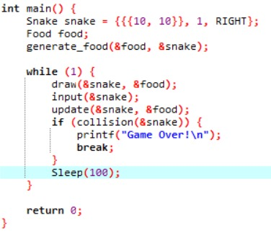

Slide 12
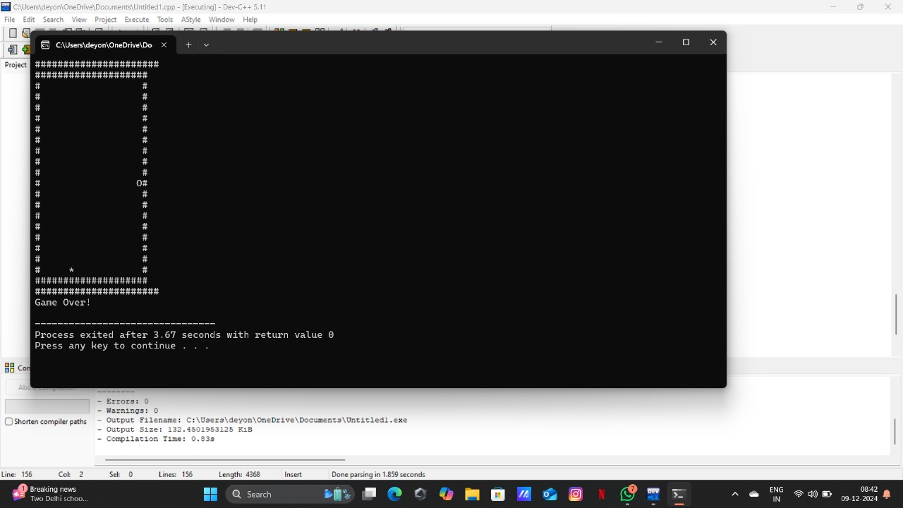
Output

Slide 13
Conclusion
In conclusion, developing the Snake Game in C programming is an excellent project that effectively combines simplicity with the opportunity to learn and apply essential programming concepts. For beginners, it serves as an accessible introduction to key programming techniques such as control structures (loops and conditionals), arrays, dynamic memory management, and real-time input handling. The game’s core mechanics—moving the snake, eating food, and avoiding collisions—are straightforward, making it easy to understand and implement while still providing room for learning. As the game progresses, developers can expand its functionality by adding features like increasing difficulty, high scores, and improved collision detection, which helps to develop more advanced problem-solving skills. The text-based graphics and real-time updates give immediate feedback, allowing programmers to see the results of their work quickly and make iterative improvements. This instant feedback, combined with the familiar nature of the game, keeps the project engaging and motivating. Additionally, the simplicity of the game's interface (run in a terminal or console) makes it highly portable and lightweight, making it a perfect choice for beginners to practice in a low-overhead environment. Overall, the Snake Game project in C is not only a fun and rewarding challenge but also an effective way to master foundational programming skills. As developers progress, they can enhance the game with additional complexity, helping them grow from basic to more advanced coding practices in C.

Slide 14
References
1. Books and Guides
"Beginning C Programming" by Ivor Horton
This book provides an introduction to C programming and covers basic concepts, including how to create games like Snake using simple C techniques.
"C Programming Absolute Beginner's Guide" by Greg Perry and Dean Miller
This book includes examples of C programming concepts and projects, some of which involve game development.
2. Online Tutorials and Articles
GeeksforGeeks (C Programming Section)
GeeksforGeeks provides many tutorials on game development in C, including guides on how to create simple games like Snake.
URL: https://www.geeksforgeeks.org/c-programming-language/
TutorialsPoint (C Programming Tutorial)
TutorialsPoint offers comprehensive tutorials on C programming, including how to create various types of games.
URL: https://www.tutorialspoint.com/cprogramming/index.htm

Slide 15
3. YouTube Tutorials
CodeWithHarry
CodeWithHarry has various programming tutorials in C, including creating simple games like Snake. These can provide a step-by-step guide to building your own version.
URL: https://www.youtube.com/c/CodeWithHarry
freeCodeCamp
FreeCodeCamp offers tutorials on game development, and their C programming tutorials can help beginners create games like Snake.
URL: https://www.youtube.com/c/Freecodecamp

Slide 16
4. Online Communities
Stack Overflow
Many developers and learners on Stack Overflow discuss issues related to Snake game development in C. You can find solutions to common problems and ask for help when developing your own Snake game.
URL: https://stackoverflow.com/
Reddit - r/Programming
Reddit's programming communities often share resources and projects related to game development in C, including Snake game projects.
URL: https://www.reddit.com/r/programming/

Slide 17


